Slide 1
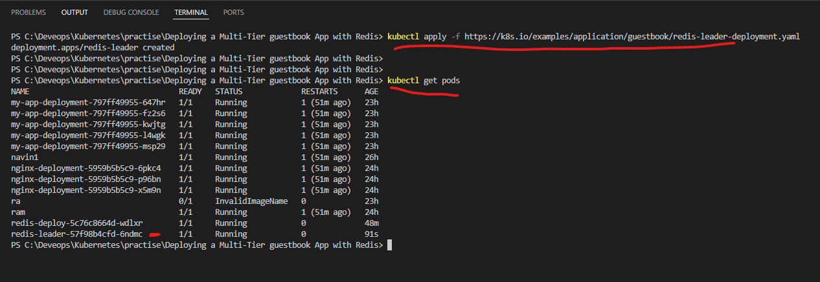
Deploying a Multi-Tier guestbook App with Redis

Slide 2
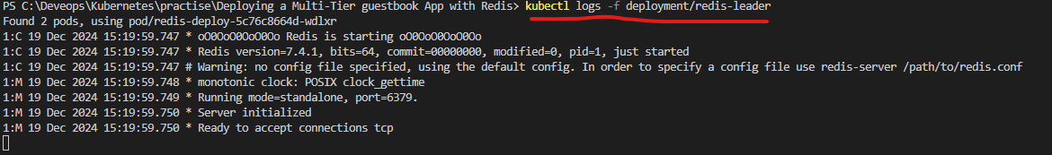
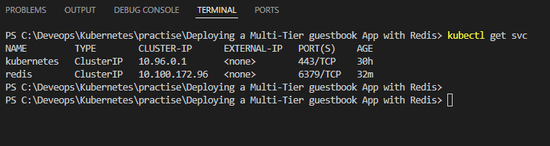
To view the logs
To view the service list

Slide 3
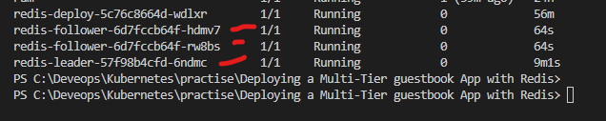
Create the Redis Follower Deployment
You’ll see two follower pods plus your existing leader:

Slide 4
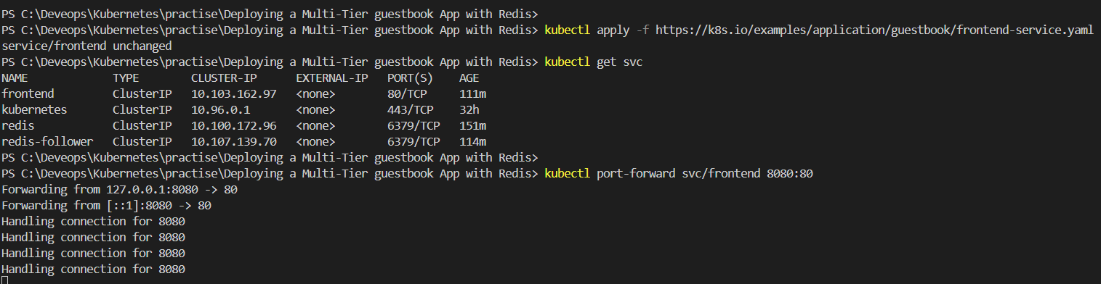
Step 4 and 5

Slide 5
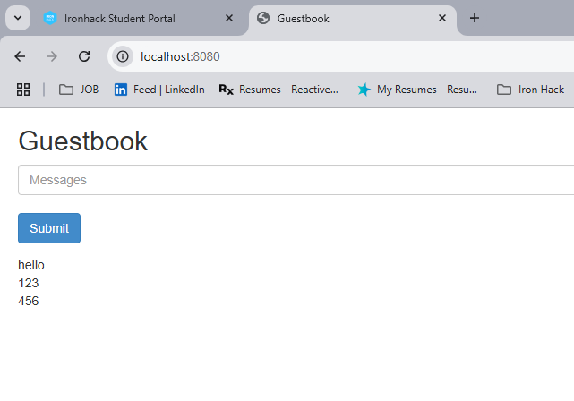
Guest book output

Slide 6
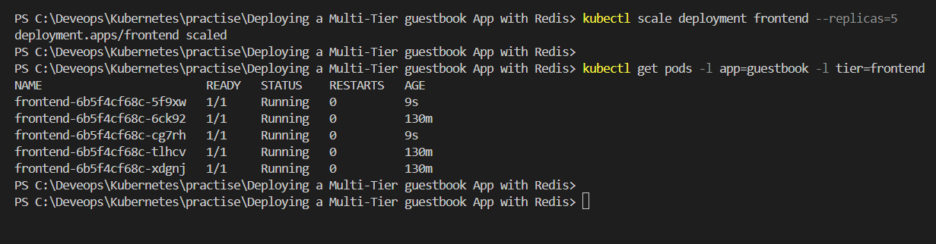
Step 6 : scaling front end

Slide 7
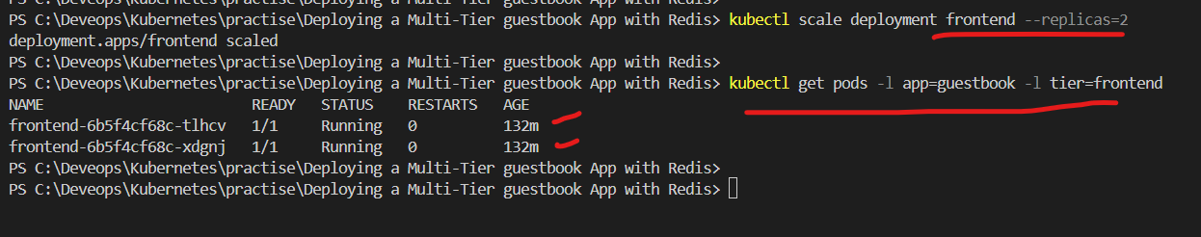
kubectl scale deployment frontend --replicas=2

Slide 8
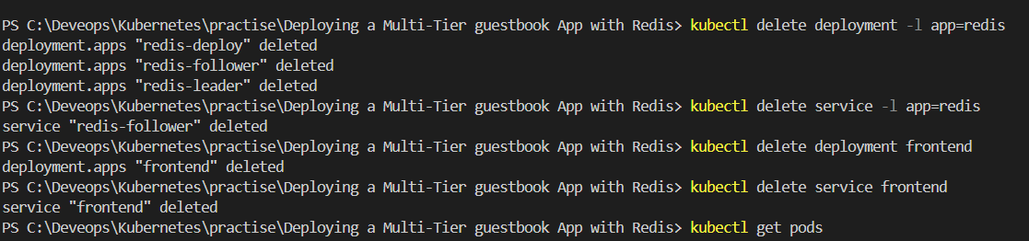
Cleanup

